Slide 1

Mandala
In today's society, the atrocities on women are increasing day by day. Develop a software or a website for their safety in case of emergencies. Theme: Travel/Tourism- Women Safety

Slide 2
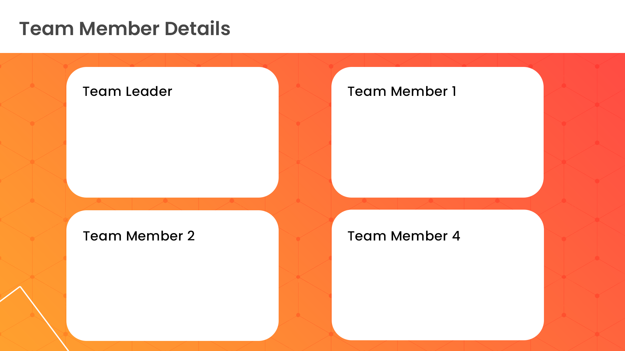
Saumyamani Bhardwaz
Rohan Godha
3
3
Kunal Pidiha
Tavishi Vemuri
3
3

Slide 3
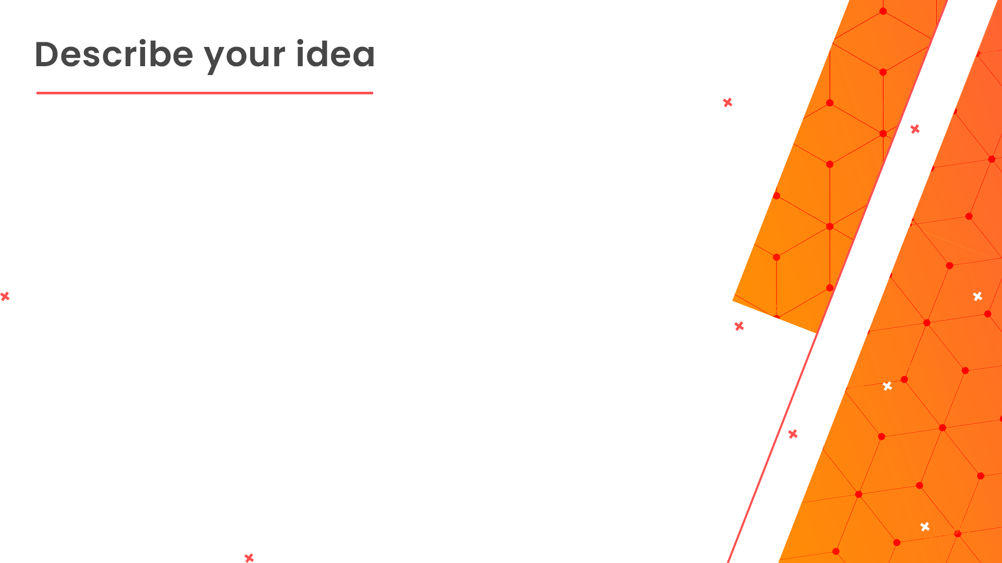
In today's society, the atrocities on women are increasing day by day. Every second morning or other, we get to hear that once again! another girl was harassed publically, eve-teased, left alone to suffer from never ending pain for the rest of her life after raping her vigorously on the streets of the "developed and educated society".
The problem which arises is the need for such a system which can provide a support to those females of the society who have to face this daily, in bus, in sub-ways, on streets and in the office canteen too.

Slide 4
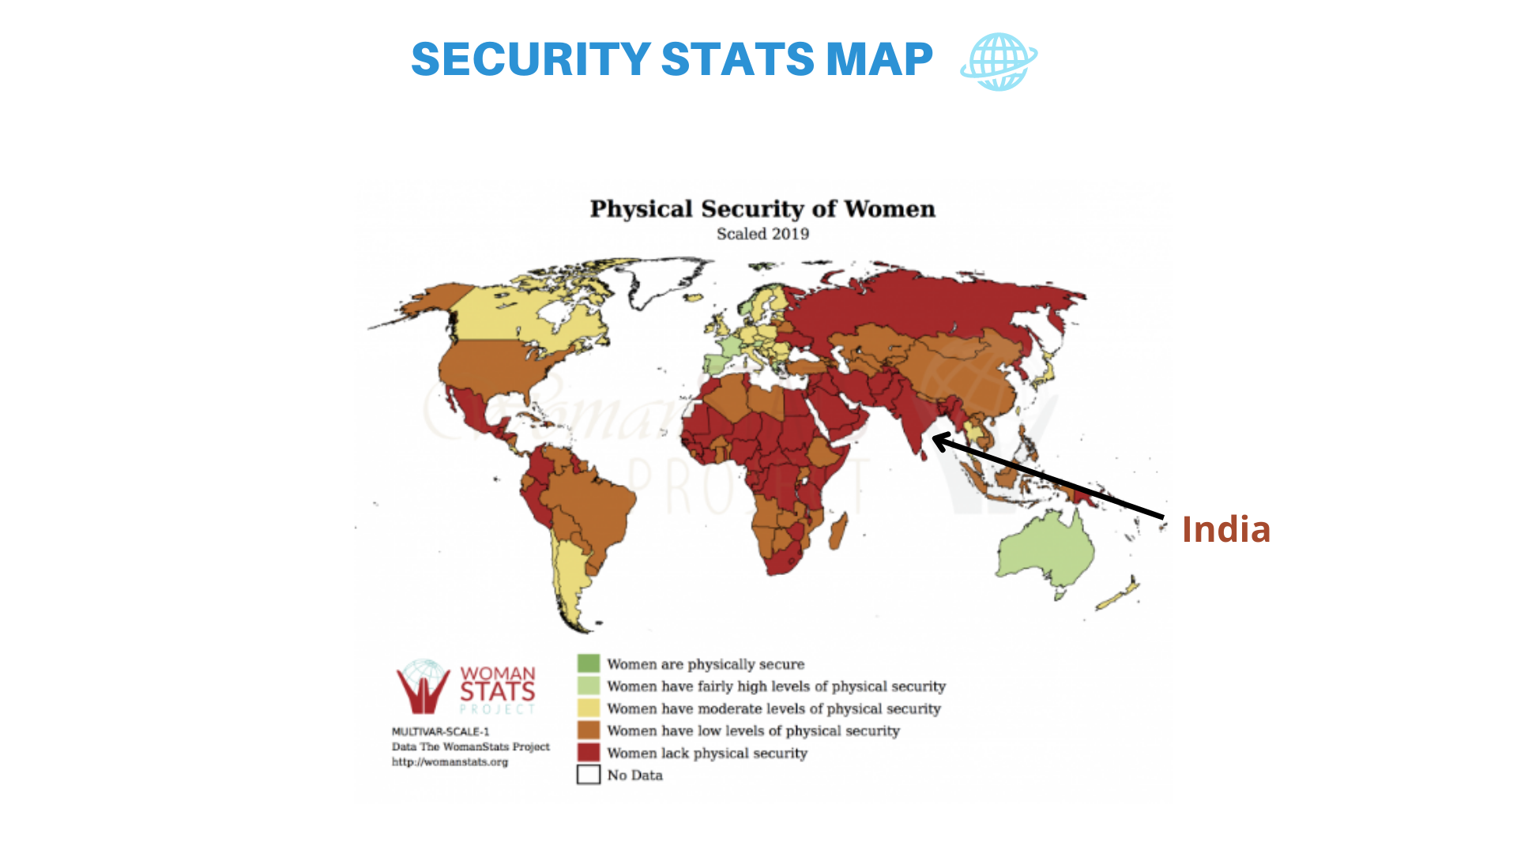
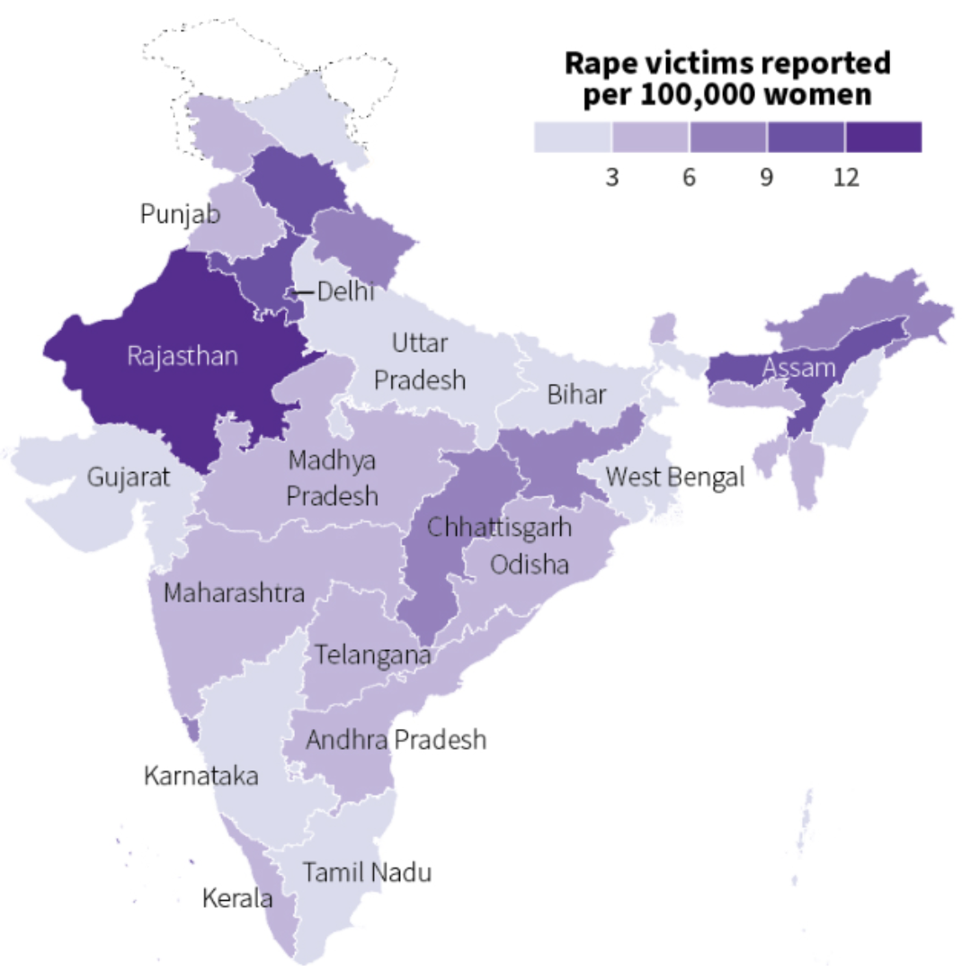
Women Crime Statistics
In India
Women Crime Statistics
In India

Slide 5
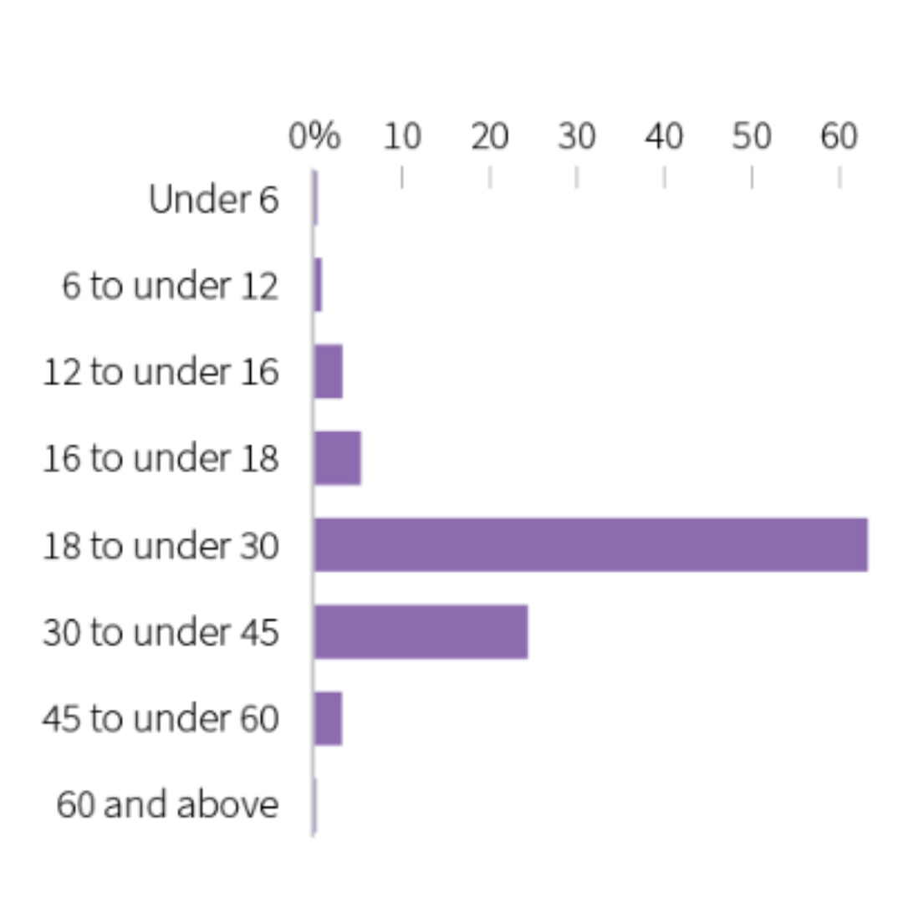
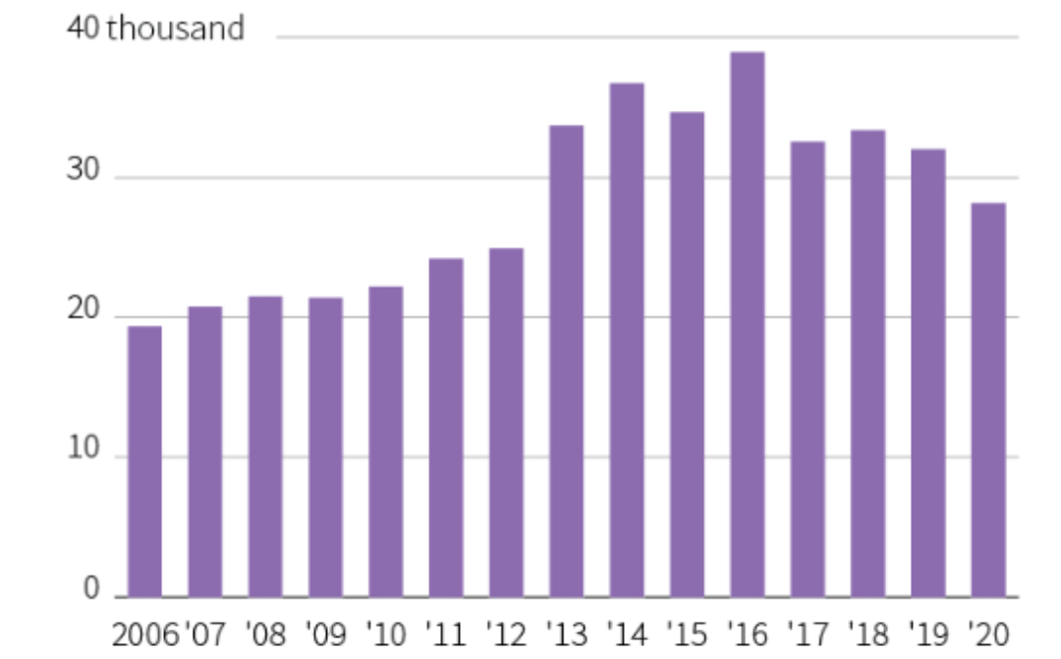
Rape cases with female victims by age group Total rape cases reported by year

Slide 6

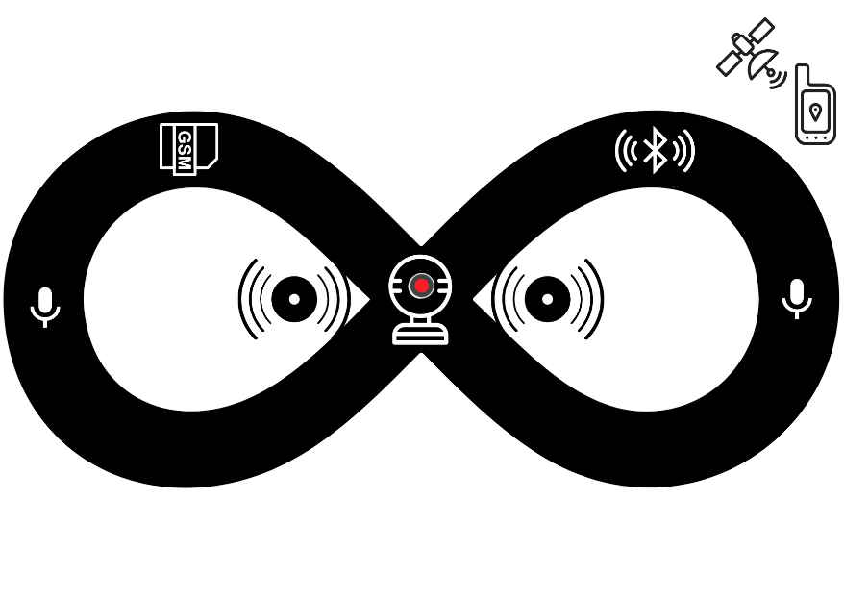

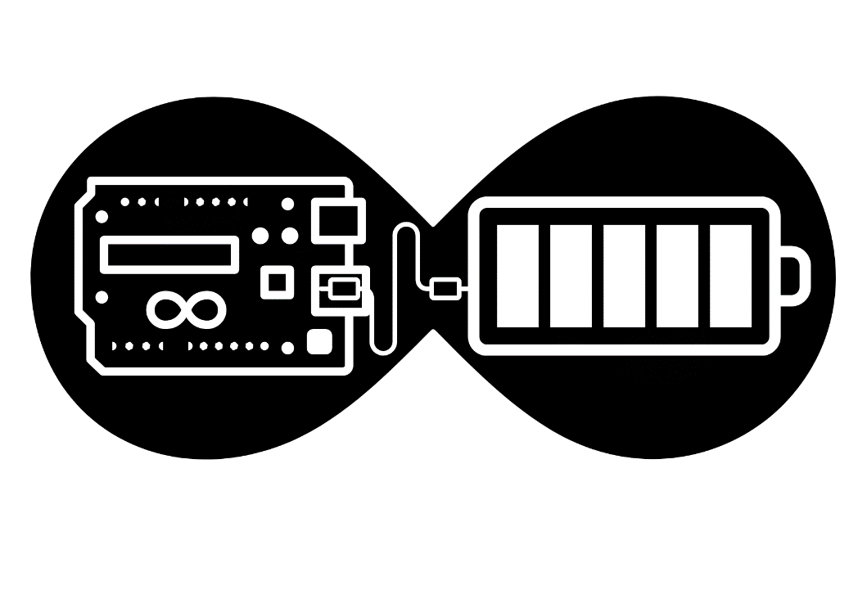

Slide 7

We are going to solve this issue by creating such a website along with a locket called "Mandala" which the woman can wear to assist her while she is traveling alone or feeling unsafe.
The locket would have the following features:
-GPS Tracker.
-ULTRA LUMINENT FLASH.
-Ease to contact the 5 Family Members in the times of Emergency.
-Contact the nearest police station.
-Notifying the nearest women's safety patrolling center.
-High Volume Buzzer to draw the public's attention.
-Neon Coloured Light to be easily identified by the rescue team.
-Identification of Harassment Hotspot Zones.

Slide 8
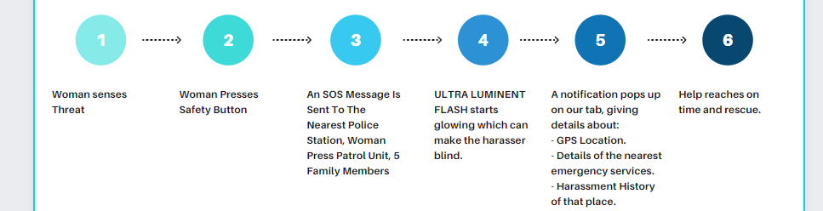
Flowchart

Slide 9
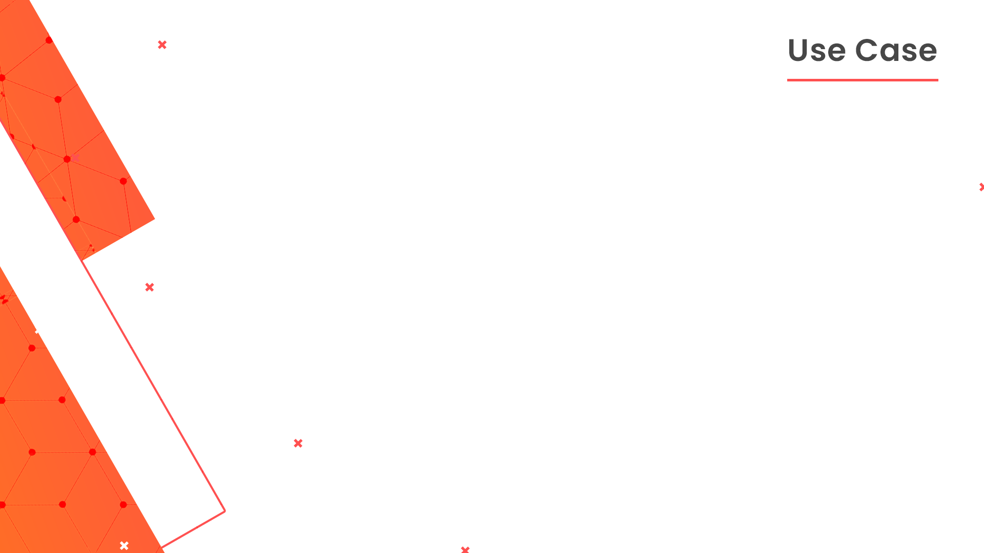
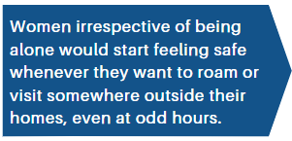
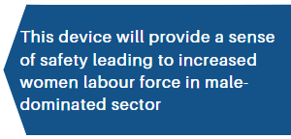
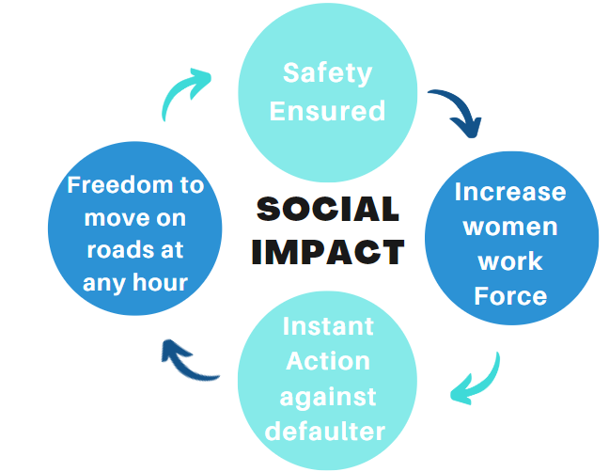
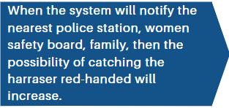
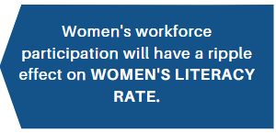

Slide 10
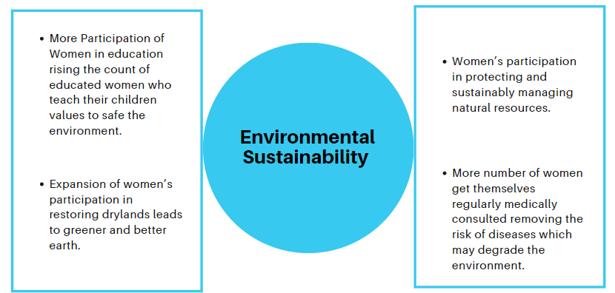

Slide 11

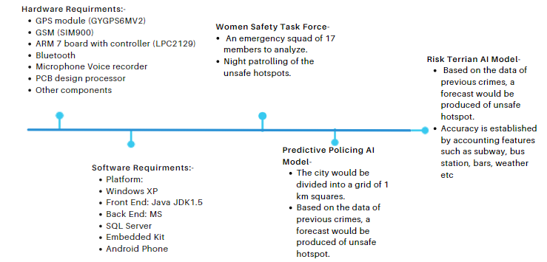

Slide 12
Our plan is to integrate IoT, and Web Development under one umbrella.
Once the woman wearing this locket-alike device pushes the SOS button, the alert system would get activated and various kinds of safety functionalities like sharing location and tracking would start and the rescue team would be there to help on the instance.
All of this would be monitored and handled through our website that we would be creating as a part of this project.

Slide 13
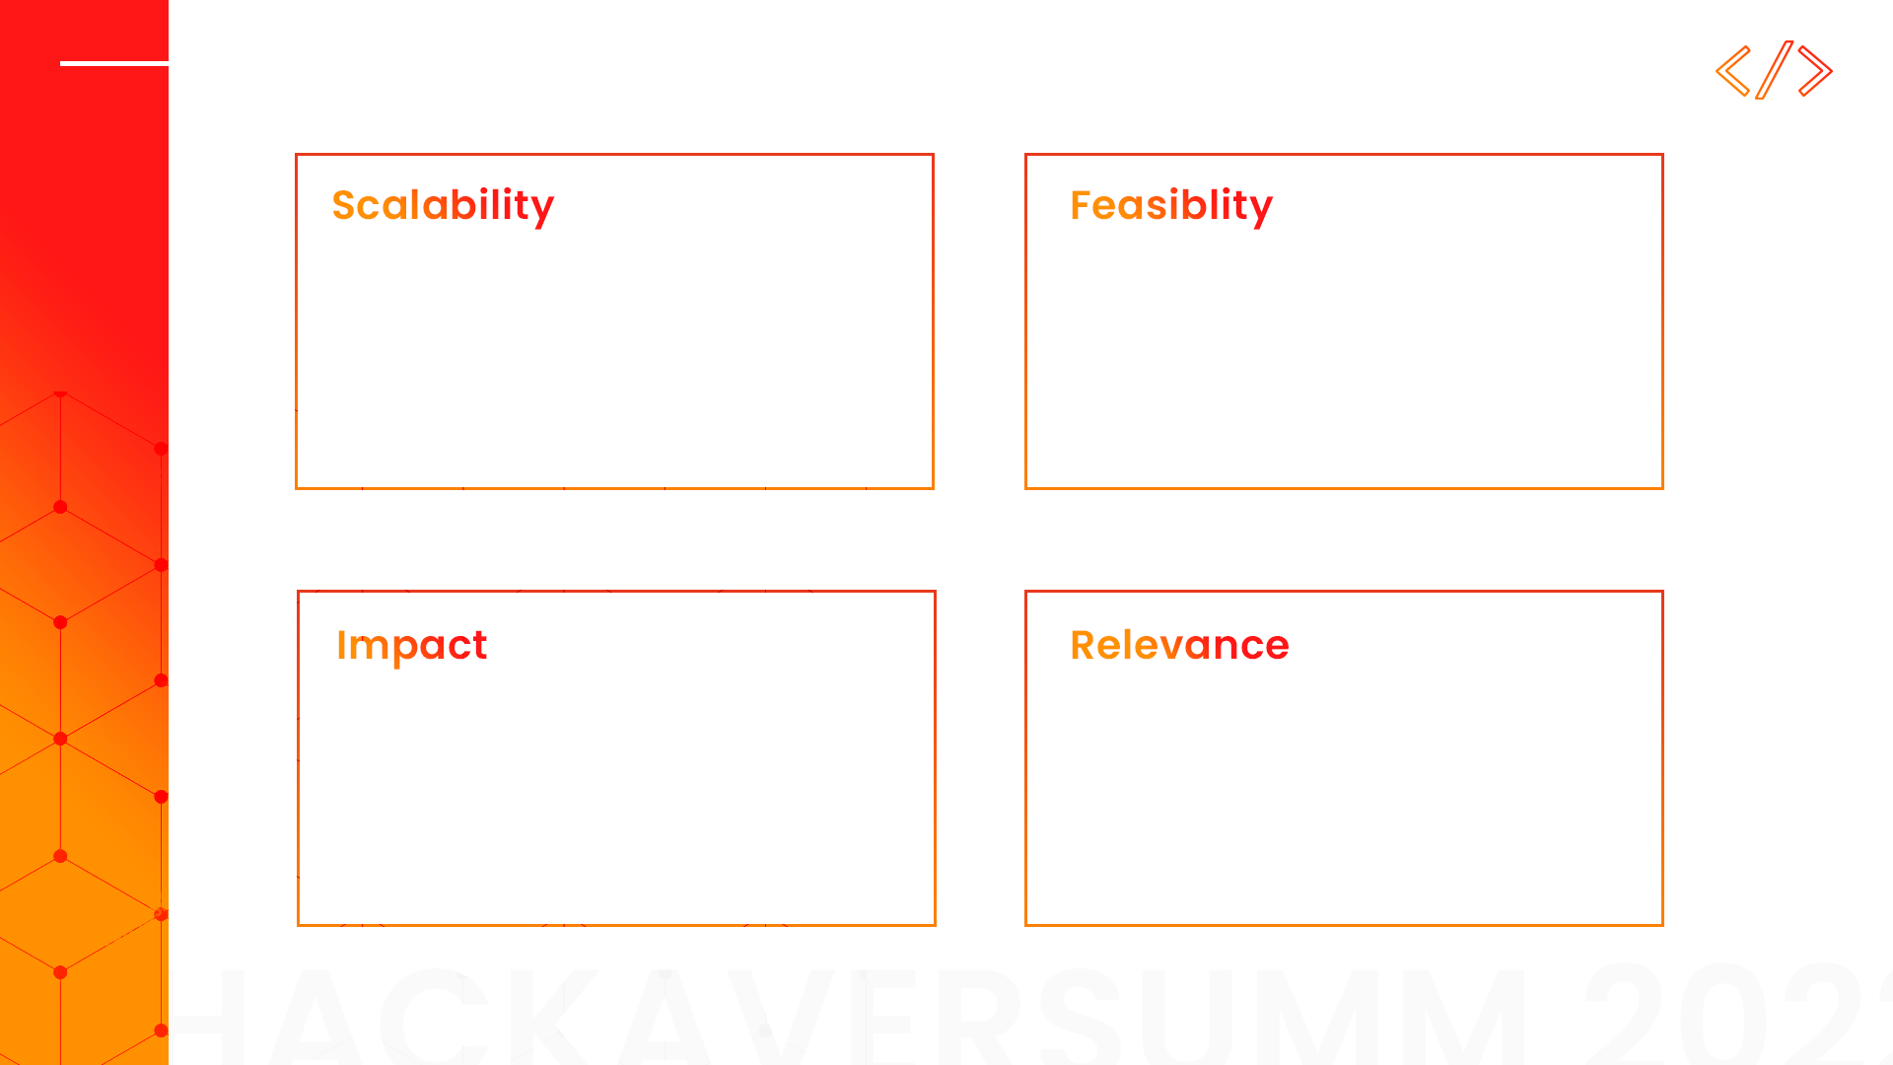
An emergency squad of 17 members to analyze.
Night patrolling of the unsafe hotspots
The city would be divided into a grid of 1 km squares.
Accuracy is established by accounting features such as subway, bus station, bars, weather, etc.
Based on the data of previous crimes, a forecast would be produced of unsafe hotspot.
Based on the data of previous crimes, a forecast would be produced of unsafe hotspot.
Accuracy is established by accounting features such as subway, bus station, bars, weather etc
More Participation of Women in education rising the count of educated women who teach their children values to safe the environment.
Can provide a support to those females of the society who have to face this daily, in bus, in sub-way, on streets and in the office canteen too.

Slide 14


